Slide 1
Bengali Handwritten AI Grapheme Recognition
Image Processing

Slide 2
Bengali As A Language
It is the 5th most widely spoken Language
It is the national Language of Bangladesh
Approximately 228 million native speakers
Influenced hugely by Sanskrit
49 letters- 38 consonants and 11 vowels

Slide 3
Why bother?
Combination of root letter, vowel diacritic and consonant diacritic creates too many possible graphemes for application in OCRs. By separating them, we observe and exponential reduction in the number of labels to be created.
The dataset is provided by a non profit organization named Bengali.AI based in Bangladesh whose objective is to democratize and accelerate research in Bengali Language technologies and to promote machine learning education

Slide 4
The Project
We implement a neural network model using Convolutional layers and Dense layers in order and pass processed 64*64 numpy array of images and their corresponding labels into it.
The model is supposed to be able to recognize a character and output the root letter, the vowel diacritic and the consonant diacritic, present in the character, in unicode format.

Slide 5
Keras
Open source software library that provides a Python interface for Artificial neural networks
It acts as an API built on top of TensorFlow library
It is designed to enable fast experimentation with deep neural networks.
Focus in being friendly, modular and extensible
Lincensed to MIT
Contains numerous implementations of layers,objectives,activation functions and optimiers

Slide 6
Matplotlib
Is a comprehensive library for creating static animated and interactive visualizations in Python
“https://matplotlib.org/stable/users/index.html” contains the latest Matplotlib documentation and User guide
We use Pyplot.plot to plot the array we pass through it (containing training accuracies over time)

Slide 7
NumPy
Fundamental package for scientific computing in Python.
Provides a multidimensional array object, various derived objects(masked arrays and matrices), and an assortment of routines for fast operations on arrays including mathematical, logical, shape manipulation, sorting, selecting, I/O, discrete FOurier transforms and much more
“https://numpy.org/doc/” contains the documentation for numpy

Slide 8
Convolutional Neural Networks
Also known as shift invariant or space invariant artificial neural networks, based on the shared weight architecture.
CNNs are regularized versions of multilayer perceptrons.
Inspired by biological processes in that the connectivity pattern between neurons resembles the organization of the animal visual cortex.
CNNs use relatively little preprocessing compared to other image classification algorithms.

Slide 10
Activation Functions
In artificial neural networks, the activation function of a node defines the output of that node given an inpu or set of inputs.
Activation functions are inspired by the activation of neurons in our brain, which activate in response to different stimuli
For our purposes, we use ReLU and softmax(only for the last layer)

Slide 11



ADAM optimizer
Adaptive Moment Estimation
It finetunes the learning rate as training progresses

Slide 13
Preprocessing the dataset
The images are stored in a parquet(binary, columnar) format as grayscale [0,255]
We create a pandas dataframe from the parquet and extract the pixel values. These values are stored within a numpy array.
OpenCV is used to convert the image to a smoothened binary version, followed by a search for contours. The extreme points in the set of contours are used to form a box(with padding of 15 pixels if possible). This box is used to crop the images
The images are finally resized to 64*64 and blurred(Gaussian).

Slide 14
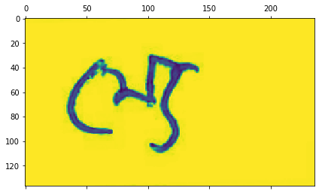
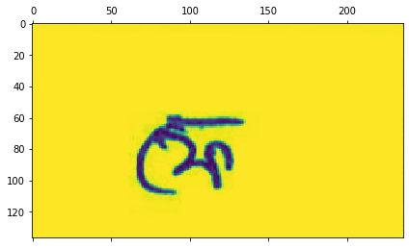
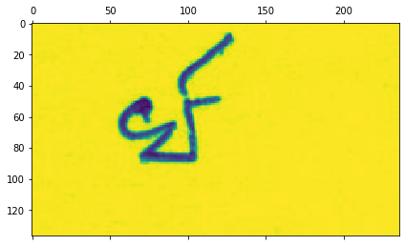
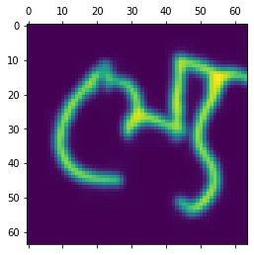
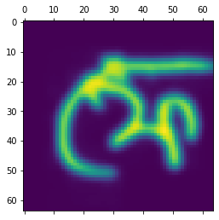
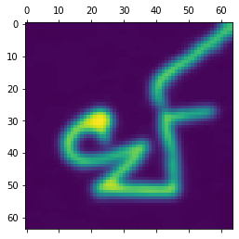
Before(above) and after(below) processing

Slide 15
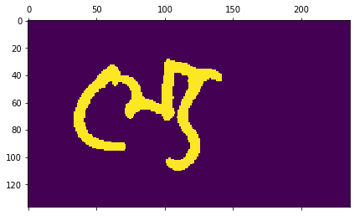
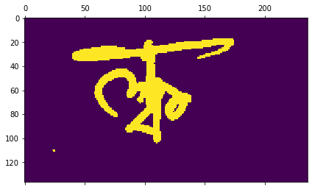
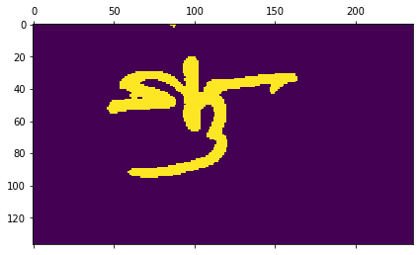
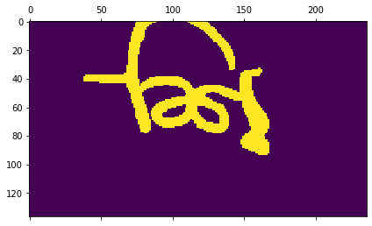

Slide 16
Network structure
The network consists of Convolutional hidden layers, with batch normalizations, dropouts and Max pooling layers arranged so as to keep tensor sizes compatible.
There is a Global Average Pooling Layer which flattens the tensors before they are passed to the Dense Layers.
There are 3 output Dense Layers having 168, 11 and 7 nodes denoting the root letter, vowel diacritic and consonant diacritic respectively.
The input layer takes in 64*64 grayscale inverted images.

Slide 17
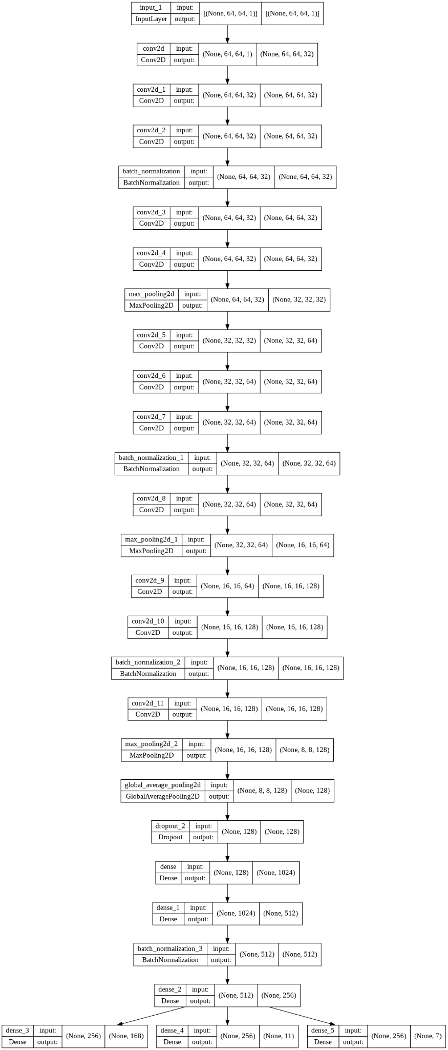
Structure of the model
Structure of the model

Slide 18
Training the model
The model is trained with a batch size of 200 and for 30 epochs.
We use the categorical cross entropy loss function for evaluating the gradient
Accuracy metric is used for learning
20% of the training data is separated out for validation during training.

Slide 19
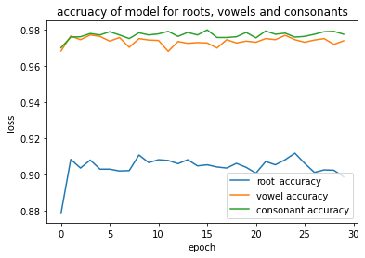
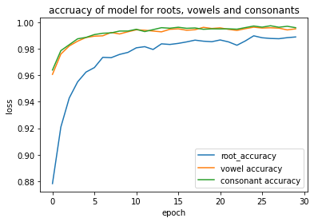
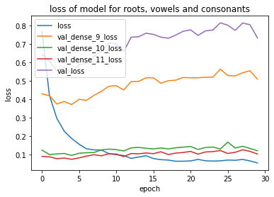

Slide 20
Testing the model
There were 840 images and labels kept aside for testing purposes.
The model gave 91.31% accuracy on root letter labels, 97.98% accuracy on vowel diacritic labels and 96.97% on consonant diacritic labels
It was also able to predict our handwritings with remarkable accuracy.

Slide 21
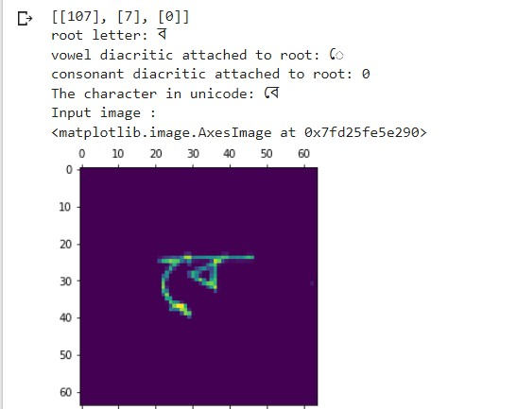
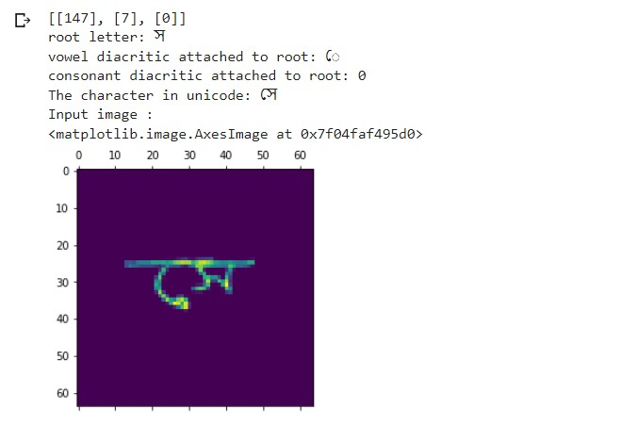
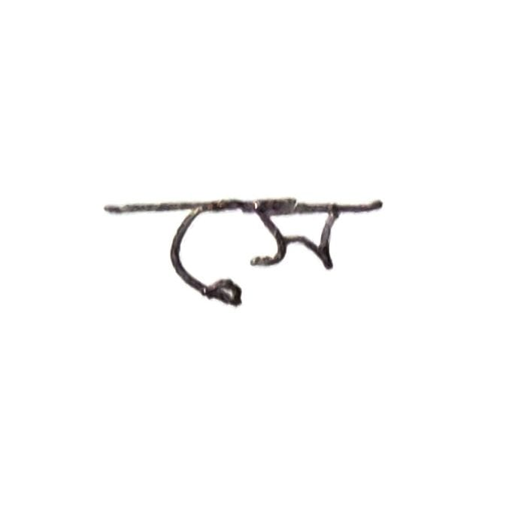
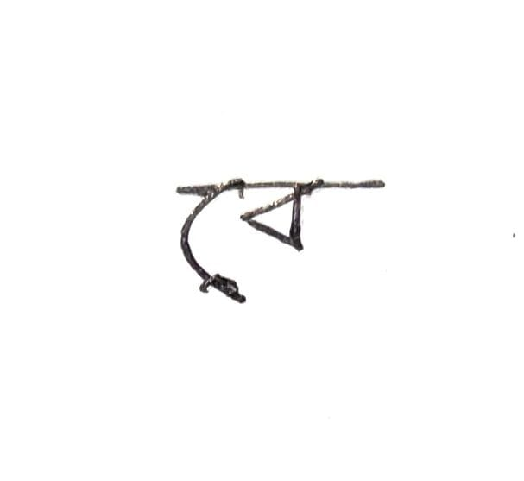

Slide 22
Conclusion
The model predicts handwritten graphemes with remarkable accuracy.
It reduces the number of possible predictions required by predicting root, vowels and consonants separately.
Effective segmentation techniques on the Bengali language can make it possible for this model to work on words, sentences and even paragraphs.

Slide 23
Conclusion(continued)
The deep learning has provided outstanding performance in many recognition tasks of natural language processing. DCNNs, in general, are extremely effective Machine Learning models. But without the consideration of the hardware available, DCNNs are very costly to get it trained.
We hope that our attempts make a difference to the presence of Bengali in our digital era.

